Slide 1
1587: COMMUNICATION SYSTEMS 1 Local Area Networks
Dr. George Loukas
University of Greenwich, 2015-2016

Slide 2
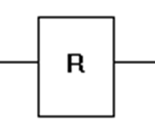
Networks
Digital transmission over a distance
50 km
50 km
Network of nodes

Slide 3
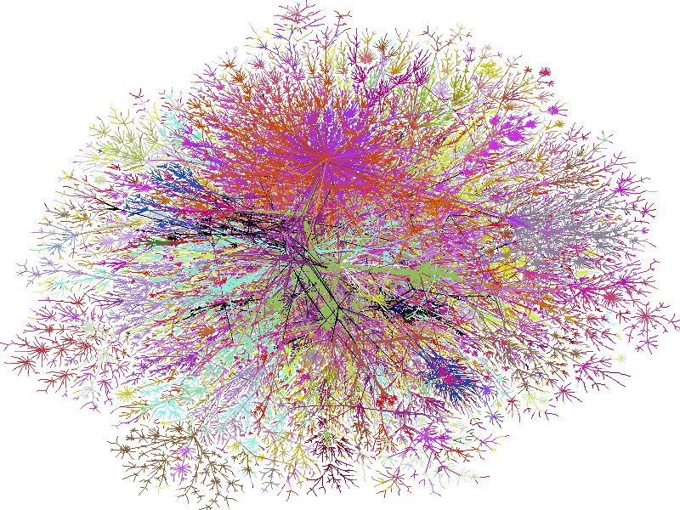
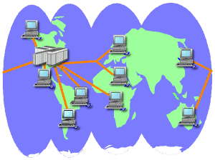
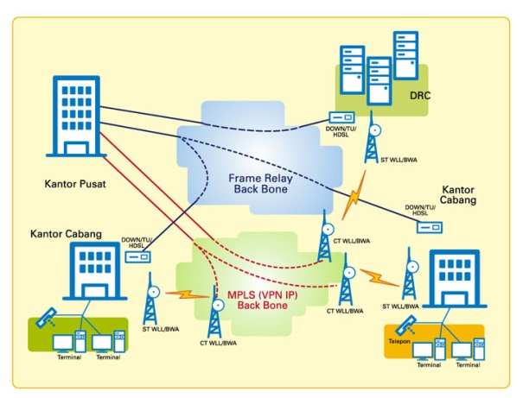
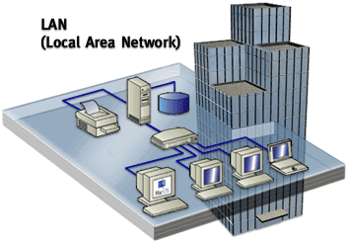
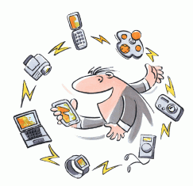
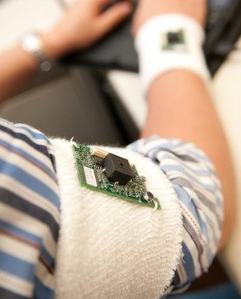
Type of network by area covered
Internet
WAN
Wide Area Network
MAN
Metropolitan Area Network
LAN
Local Area Network
PAN
Personal Area Network
BAN
Body Area Network

Slide 4
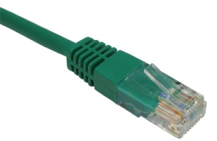
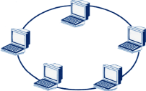
Local Area Network
owned by the organisation that uses it
a variety of devices can be attached to it
internal data rates tend to be high
a significant capital investment
Architecture depends on:
LAN
Local Area Network
TOPOLOGY
TRANSMISSION MEDIUM
METHOD OF SHARING

Slide 5
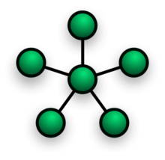
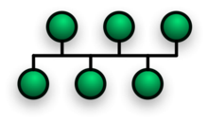
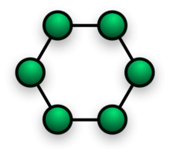
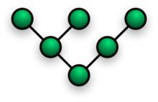
TOPOLOGY
TRANSMISSION MEDIUM
METHOD OF SHARING
STAR
BUS
RING
TREE
Notes:
Ring:
– very high speed links over long distances
– single link or repeater failure disables network
Star:
– uses natural layout of wiring in building
– best for short distances
– high data rates for small number of devices
Both bus and tree topologies are characterized by the use of a multipoint medium. For the bus, all stations attach, through appropriate hardware interfacing known as a tap, directly to a linear transmission medium, or bus. Full-duplex operation between the station and the tap allows data to be transmitted onto the bus and received from the bus. A transmission from any station propagates the length of the medium in both directions and can be received by all other stations. At each end of the bus is a terminator, which absorbs any signal, removing it from the bus.
The tree topology is a generalization of the bus topology. The transmission medium is a branching cable with no closed loops. The tree layout begins at a point known as the headend. One or more cables start at the headend, and each of these may have branches. The branches in turn may have additional branches to allow quite complex layouts. Again, a transmission from any station propagates throughout the medium and can be received by all other stations.

Slide 6
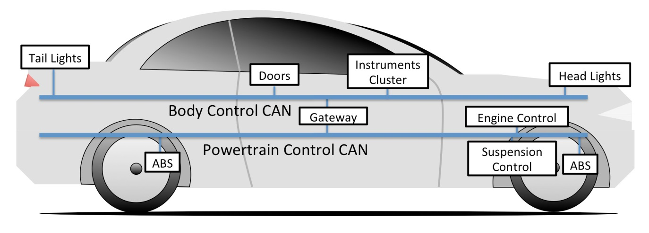
BUS
TOPOLOGY
TRANSMISSION MEDIUM
METHOD OF SHARING
transmission from any station is received by all other stations
BUS
tap
terminator
bus
terminator
Notes:
Both bus and tree topologies are characterized by the use of a multipoint medium. For the bus, all stations attach, through appropriate hardware interfacing known as a tap, directly to a linear transmission medium, or bus. Full-duplex operation between the station and the tap allows data to be transmitted onto the bus and received from the bus. A transmission from any station propagates the length of the medium in both directions and can be received by all other stations. At each end of the bus is a terminator, which absorbs any signal, removing it from the bus.
Two problems present themselves in these topologies. First, because a transmission from any one station can be received by all other stations, there needs to be some way of indicating for whom the transmission is intended. Second, a mechanism is needed to regulate transmission. To solve these problems, stations transmit data in small blocks, known as frames. Each frame consists of a portion of the data that a station wishes to transmit, plus a frame header that contains control information. Each station on the bus is assigned a unique address, or identifier, and the destination address for a frame is included in its header. The use of frames also provides the basic tool for the regulation of access. In particular, the stations take turns sending frames in some cooperative fashion. This involves putting additional control information into the frame header.

Slide 7
BUS
TREE
TOPOLOGY
TRANSMISSION MEDIUM
METHOD OF SHARING
generalisation of the bus topology
transmission from any station is received by all other stations
TREE
headend
Notes:
The tree topology is a generalization of the bus topology. The transmission medium is a branching cable with no closed loops. The tree layout begins at a point known as the headend. One or more cables start at the headend, and each of these may have branches. The branches in turn may have additional branches to allow quite complex layouts. Again, a transmission from any station propagates throughout the medium and can be received by all other stations.

Slide 8
BUS
TREE
RING
TOPOLOGY
TRANSMISSION MEDIUM
METHOD OF SHARING
– very high speed links over long distances
– single link or repeater failure disables network
a closed loop of repeaters joined by point to point links
receive data on one link & retransmit on another (links unidirectional and stations attach to repeaters)
data in frames
circulate past all stations
destination recognises address and copies frame
frame circulates back to source where it is removed
RING

Slide 9
BUS
TREE
RING
STAR
TOPOLOGY
TRANSMISSION MEDIUM
METHOD OF SHARING
STAR
each station connects to central node
central node can broadcast or act as frame switch
only one station can transmit at a time
– uses natural layout of wiring in building
– best for short distances
– high data rates for small number of devices
Notes:
In the star LAN topology, each station is directly connected to a common central node. Typically, each station attaches to a central node via two point-to-point links, one for transmission and one for reception. In general, there are two alternatives for the operation of the central node. One approach is for the central node to operate in a broadcast fashion. A transmission of a frame from one station to the node is retransmitted on all of the outgoing links. In this case, although the arrangement is physically a star, it is logically a bus: A transmission from any station is received by all other stations, and only one station at a time may successfully transmit. In this case, the central element is referred to as a hub. Another approach is for the central node to act as a frame-switching device. An incoming frame is buffered in the node and then retransmitted on an outgoing link to the destination station.

Slide 10
BUS
TREE
RING
STAR
TOPOLOGY
TRANSMISSION MEDIUM
METHOD OF SHARING
STAR
each station connects to central node
central node can broadcast or act as frame switch
only one station can transmit at a time
– uses natural layout of wiring in building
– best for short distances
– high data rates for small number of devices
Notes:
In the star LAN topology, each station is directly connected to a common central node. Typically, each station attaches to a central node via two point-to-point links, one for transmission and one for reception. In general, there are two alternatives for the operation of the central node. One approach is for the central node to operate in a broadcast fashion. A transmission of a frame from one station to the node is retransmitted on all of the outgoing links. In this case, although the arrangement is physically a star, it is logically a bus: A transmission from any station is received by all other stations, and only one station at a time may successfully transmit. In this case, the central element is referred to as a hub. Another approach is for the central node to act as a frame-switching device. An incoming frame is buffered in the node and then retransmitted on an outgoing link to the destination station.

Slide 11
BUS
TREE
RING
STAR
TOPOLOGY
TRANSMISSION MEDIUM
METHOD OF SHARING
The real topology is usually a combination of Bus, Tree, Ring and Star topologies.
Choice of topology depends on
reliability
expandability
performance
Need to consider in context of:
transmission medium, wiring layout and access control

Slide 12
BUS
TREE
RING
STAR
TOPOLOGY
TRANSMISSION MEDIUM
METHOD OF SHARING
Key factors for choosing transmission medium:
Cost per meter and cost of installation
Speed (number of bits per second that can be transmitted reliably)
Attenuation (the signal weakens and is distorted by the medium itself)
Electromagnetic Interference
Types of data supported
Reliability
Security

Slide 13
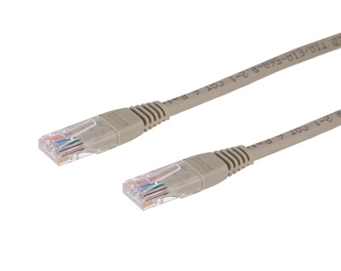
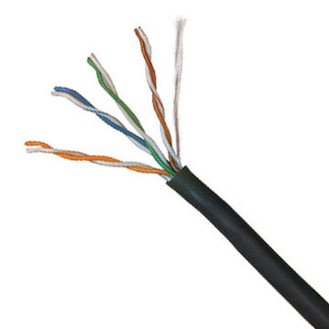
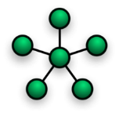
TREE
Twisted Pair
BUS
RING
STAR
GUIDED
TOPOLOGY
TRANSMISSION MEDIUM
METHOD OF SHARING
Twisted pair
Oldest option but still the most popular, esp. Cat 5
very cheap
thin and flexible
can run for several km without amplification
typically used in Star topologies
but
a bit fragile

Slide 14
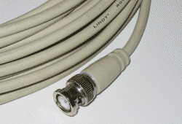
TREE
Twisted Pair
Coaxial
BUS
RING
STAR
GUIDED
TOPOLOGY
TRANSMISSION MEDIUM
METHOD OF SHARING
Coaxial cable
greater transmission capacity than twisted pair
less prone to interference than twisted pair
but
heavy and expensive
pretty rare today
can be baseband or broadband (transmission over a single or multiple frequencies)
Notes:
Baseband uses very simple transceiver devices that send and receive signals on a cable. The simplicity behind baseband signalling is that only three states need to be distinguished: one, zero and idle.
Broadband transceivers are much more complex because they must be able to distinguish those same states, but on multiple channels within the same cable. Because of its simplicity, baseband signalling is used on most Ethernet networks.

Slide 15
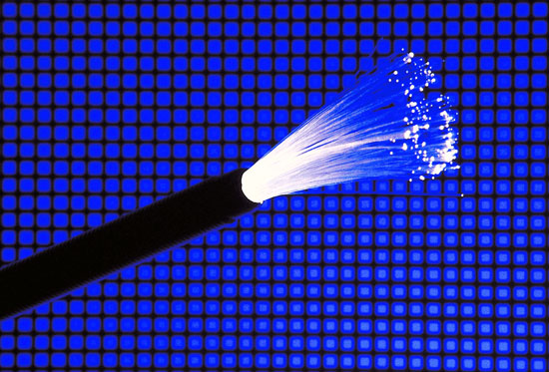
Twisted Pair
Opt. Fibre
BUS
TREE
RING
STAR
Coaxial
GUIDED
TOPOLOGY
TRANSMISSION MEDIUM
METHOD OF SHARING
Optical Fibre
thin and light
high speed - used in backbone networks
low attenuation: repeaters needed every 40 km Vs. 5 km for copper
low error rates (not affected by power-surges or electro-magnetic interference)
hard to wire-tap
Researchers have reached 1 million gigabits per second

Slide 16

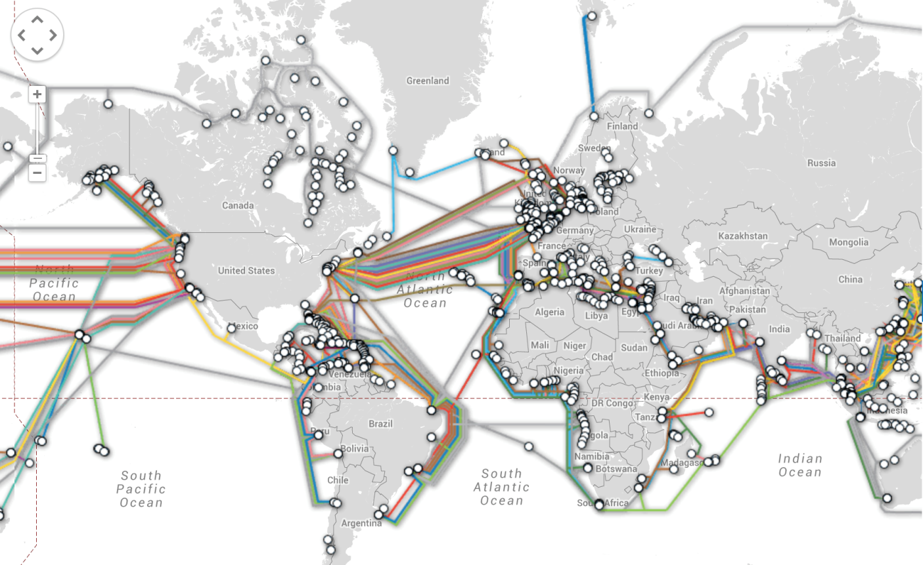
Twisted Pair
Opt. Fibre
BUS
TREE
RING
STAR
Coaxial
GUIDED
TOPOLOGY
TRANSMISSION MEDIUM
METHOD OF SHARING
Optical Fibre
Example: Submarine cables
More than 95% of international network traffic goes through submarine optical fibre cables
http://www.telegeography.com

Slide 17


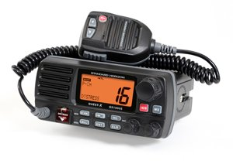

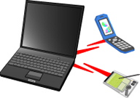
Twisted Pair
Opt. Fibre
Wireless
BUS
TREE
RING
STAR
Coaxial
GUIDED
UNGUIDED
TOPOLOGY
TRANSMISSION MEDIUM
METHOD OF SHARING
Wireless
Useful when on the move or where it is physically difficult to lay cables
Technologies:
spread spectrum technology
narrowband, high frequency radio
infra-red
Notes:
Another unguided one is laser, but it’s too unusual.

Slide 18
Twisted Pair
Opt. Fibre
Wireless
BUS
TREE
RING
STAR
Coaxial
GUIDED
UNGUIDED
TOPOLOGY
TRANSMISSION MEDIUM
METHOD OF SHARING
Some examples:
Token Bus / Token Ring
CSMA-CD

Slide 19
Twisted Pair
Opt. Fibre
Wireless
TOKEN RING
BUS
TREE
RING
STAR
Coaxial
GUIDED
UNGUIDED
TOPOLOGY
TRANSMISSION MEDIUM
METHOD OF SHARING
TOKEN RING
Developed by IBM in the early 1980s.
Based on the principle of taking turns, using tokens to control access
Each station may only transmit during its turn and can only send one frame per turn
A token is a bit sequence.
For example:
When a node wants to transmit:
– Waits for free token
– Removes free token from ring and replaces with busy token
– Transmits message
– When done transmitting, replaces busy token with free token
Busy token:
01111111
Free token:
01111110

Slide 20
Twisted Pair
Opt. Fibre
Wireless
TOKEN RING
BUS
TREE
RING
STAR
Coaxial
GUIDED
UNGUIDED
TOPOLOGY
TRANSMISSION MEDIUM
METHOD OF SHARING
FREE
BUSY
DATA
Notes:
at low utilisation a token ring can be very inefficient
at high utilisation it is a very fair way to share the network

Slide 21
Twisted Pair
Opt. Fibre
Wireless
TOKEN RING
BUS
TREE
RING
STAR
Coaxial
GUIDED
UNGUIDED
TOPOLOGY
TRANSMISSION MEDIUM
METHOD OF SHARING
Notes:
at low utilisation a token ring can be very inefficient
at high utilisation it is a very fair way to share the network

Slide 22
Contention-based protocols: CSMA
Twisted Pair
Opt. Fibre
Wireless
TOKEN RING
BUS
TREE
RING
STAR
Coaxial
CSMA
GUIDED
UNGUIDED
TOPOLOGY
TRANSMISSION MEDIUM
METHOD OF SHARING
(Carrier Sense Multiple Access)
Stations listen for clear medium (carrier sense)
if medium idle, transmit
if two stations start at the same instant, collision
wait reasonable time
if no ACK then retransmit
Utilisation depends on propagation time (medium length) and frame length
Notes:
With CSMA, a station wishing to transmit first listens to the medium to determine if another transmission is in progress (carrier sense). If the medium is in use, the station must wait. If the medium is idle, the station may transmit. It may happen that two or more stations attempt to transmit at about the same time. If this happens, there will be a collision; the data from both transmissions will be garbled and not received successfully. To account for this, a station waits a reasonable amount of time after transmitting for an acknowledgment, taking into account the maximum round-trip propagation delay and the fact that the acknowledging station must also contend for the channel to respond. If there is no acknowledgment, the station assumes that a collision has occurred and retransmits. This strategy is effective for networks in which the average frame transmission time is much longer than the propagation time. Collisions can occur only when more than one user begins transmitting within a short time interval (the period of the propagation delay). If a station begins to transmit a frame, and there are no collisions during the time it takes for the leading edge of the packet to propagate to the farthest station, then there will be no collision for this frame because all other stations are now aware of the transmission. The maximum utilization achievable using CSMA can far exceed that of ALOHA or slotted ALOHA. The maximum utilization depends on the length of the frame and on the propagation time; the longer the frames or the shorter the propagation time, the higher the utilization.

Slide 23
Twisted Pair
Opt. Fibre
Wireless
TOKEN RING
BUS
TREE
RING
STAR
Coaxial
CSMA
CSMA/CD
GUIDED
UNGUIDED
TOPOLOGY
TRANSMISSION MEDIUM
METHOD OF SHARING
With CSMA, collision occupies medium for duration of transmission
Better if stations can listen while transmitting
CSMA/CD rules:
if medium idle, transmit
if busy, listen for idle, then transmit
if collision detected, jam and then cease transmission
after jam, wait random time then retry
Notes:
CSMA has one glaring inefficiency. When two frames collide, the medium remains unusable for the duration of transmission of both damaged frames. For long frames, compared to propagation time, the amount of wasted capacity can be considerable. This waste can be reduced if a station continues to listen to the medium while transmitting. This leads to the following rules for CSMA/CD:
1. If the medium is idle, transmit; otherwise, go to step 2.
2. If the medium is busy, continue to listen until the channel is idle, then transmit immediately.
3. If a collision is detected during transmission, transmit a brief jamming signal to assure that all stations know that there has been a collision and then cease transmission.
4. After transmitting the jamming signal, wait a random amount of time, referred to as the backoff, then attempt to transmit again (repeat from step 1).
under light traffic loads CSMA-CD works well
small probability that there will be a collision
at high loads there are more frequent collisions and the network becomes unstable
Ethernet - data rate falls by 50% due to collisions
Token ring - maintains its throughput
Token ring gives a more consistent and predictable response time than an Ethernet

Slide 24
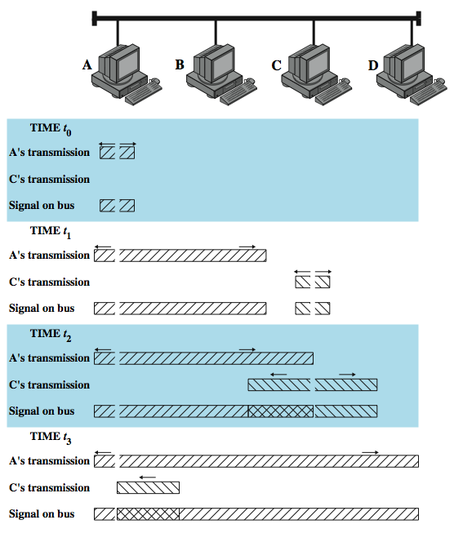
CSMA/CD Operation
t0
t1
t2
t3
Notes:
Stallings DCC8e Figure 16.2 illustrates the technique for a baseband bus. The upper part of the figure shows a bus LAN layout. At time t₀, station A begins transmitting a packet addressed to D. At t ₁, both B and C are ready to transmit. B senses a transmission and so defers. C, however, is still unaware of A's transmission (because the leading edge of A's transmission has not yet arrived at C) and begins its own transmission. When A's transmission reaches C, at t ₂, C detects the collision and ceases transmission. The effect of the collision propagates back to A, where it is detected some time later, t ₃, at which time A ceases transmission. With CSMA/CD, the amount of wasted capacity is reduced to the time it takes to detect a collision. Question: How long does that take? Let us consider the case of a baseband bus and consider two stations as far apart as possible. For example, in Figure 16.2, suppose that station A begins a transmission and that just before that transmission reaches D, D is ready to transmit. Because D is not yet aware of A's transmission, it begins to transmit. A collision occurs almost immediately and is recognized by D. However, the collision must propagate all the way back to A before A is aware of the collision. By this line of reasoning, we conclude that the amount of time that it takes to detect a collision is no greater than twice the end-to-end propagation delay.

Slide 25
Twisted Pair
Opt. Fibre
Wireless
TOKEN RING
BUS
TREE
RING
STAR
Coaxial
CSMA
CSMA/CD
GUIDED
UNGUIDED
TOPOLOGY
TRANSMISSION MEDIUM
METHOD OF SHARING
Collision Detection
On twisted pair (star-topology) - activity on more than one port is collision - use special collision presence signal
On baseband bus - collision produces higher signal voltage - collision detected if cable signal greater than single station signal
Signal is attenuated over distance - IEEE standard for coaxial cable limits: 500m for 10Base5 and 185m for 10Base2
Notes:
For baseband bus, a collision should produce substantially higher voltage swings than those produced by a single transmitter. Accordingly, the IEEE standard dictates that the transmitter will detect a collision if the signal on the cable at the transmitter tap point exceeds the maximum that could be produced by the transmitter alone. Because a transmitted signal attenuates as it propagates, there is a potential problem: If two stations far apart are transmitting, each station will receive a greatly attenuated signal from the other. The signal strength could be so small that when it is added to the transmitted signal at the transmitter tap point, the combined signal does not exceed the CD threshold. For this reason, among others, the IEEE standard restricts the maximum length of coaxial cable to 500 m for 10BASE5 and 200 m for 10BASE2.
A much simpler collision detection scheme is possible with the twisted-pair star-topology approach. In this case, collision detection is based on logic rather than sensing voltage magnitudes. For any hub, if there is activity (signal) on more than one input, a collision is assumed. A special signal called the collision presence signal is generated. This signal is generated and sent out as long as activity is sensed on any of the input lines. This signal is interpreted by every node as an occurrence of a collision.

Slide 26
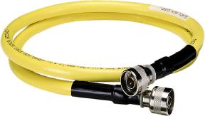
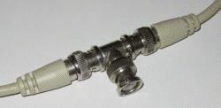
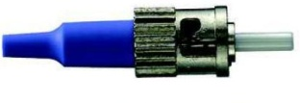
Original 10-Mbps Ethernets
Name | Cable | Max Segment length | Nodes per segment | Advantages
10Base5 | Thick coaxial | 500 m | 100 | original cable - now obsolete
10Base2 | Thin coaxial | 185 m | 30 | no hub needed
10Base-T | Twisted pair | 100 m | 1024 | cheapest system
10Base-F | Fiber optics | 2000 m | 1024 | best between buildings

Slide 27

5 minutes

Slide 28
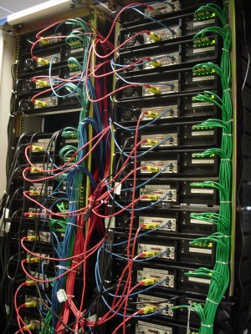
Internetworking
A single network is not always possible or preferable, especially for large and widely dispersed organisations.
By linking networks together, we can create a larger and more suitable network.
Some basic types of components are needed:
REPEATER
HUB
BRIDGE
SWITCH
ROUTER
GATEWAY
Notes:
repeater
interconnects similar LAN segments to form an extended LAN
bridge
interconnects similar LANs to form a single subnetwork
router
interconnects subnetworks to form a single network
gateway
interconnect different networks to form an integrated network

Slide 29
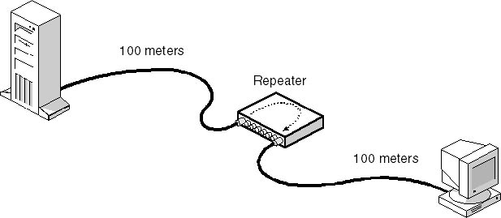
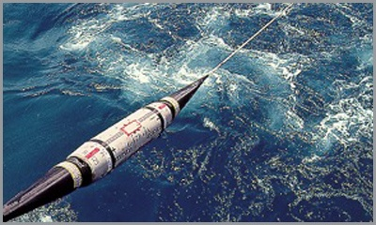
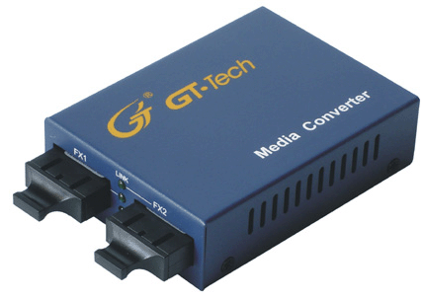
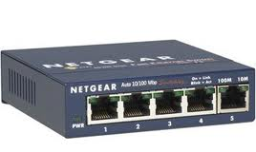
Internetworking: Repeater
A repeater connects two segments of a network at the physical layer (it physically retransmits the signals) or extends the distance limitation of the cable
100 m
100 m
Hubs are multi-port repeaters. When a data frame arrives at one port, it is broadcast to all other ports so that all segments of the LAN can see all frames.
Bandwidth shared between the ports.
A 10/100 Mbps hub will allocate a total of 10/100 Mbps to its ports
REPEATER
HUB
BRIDGE
SWITCH
ROUTER
GATEWAY
Notes:
repeater
interconnects similar LAN segments to form an extended LAN
bridge
interconnects similar LANs to form a single subnetwork
router
interconnects subnetworks to form a single network
gateway
interconnect different networks to form an integrated network
The hub is the active central element of a star-topology LAN. Each station is connected to the hub by two lines (transmit and receive). The hub acts as a repeater: When a single station transmits, the hub repeats the signal on the outgoing line to each station. Ordinarily, the line consists of two unshielded twisted pairs. Because of the high data rate and the poor transmission qualities of unshielded twisted pair, the length of a line is limited to about 100 m. As an alternative, an optical fiber link may be used. In this case, the maximum length is about 500 m. Note that although this scheme is physically a star, it is logically a bus: A transmission from any one station is received by all other stations, and if two stations transmit at the same time there will be a collision.

Slide 30
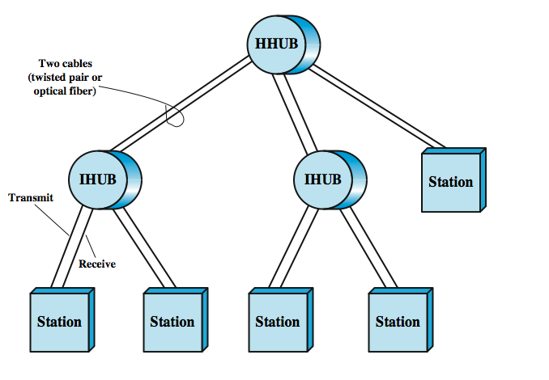
Two Level Hub Topology
REPEATER
HUB
BRIDGE
SWITCH
ROUTER
GATEWAY
Notes:
Multiple levels of hubs can be cascaded in a hierarchical configuration. Stallings DCC8e Figure 15.12 illustrates a two-level configuration. There is one header hub (HHUB) and one or more intermediate hubs (IHUB). Each hub may have a mixture of stations and other hubs attached to it from below. This layout fits well with building wiring practices. Typically, there is a wiring closet on each floor of an office building, and a hub can be placed in each one. Each hub could service the stations on its floor.

Slide 31
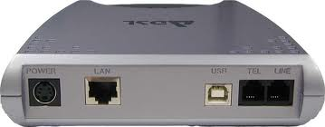
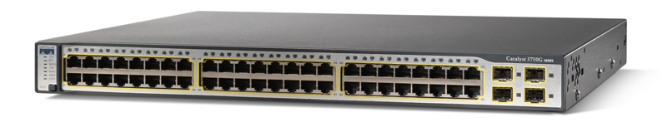
Internetworking: Bridge
A bridge interconnects two similar LANs
Used where extending with repeaters is not enough
Does not modify the format or content of frames
Operates in the data link layer
Switches are multi-port bridges
A 10/100 Mbps hub will allocate 10/100 Mbps to each of its ports
REPEATER
HUB
BRIDGE
SWITCH
ROUTER
GATEWAY
Notes:
In virtually all cases, there is a need to expand beyond the confines of a single LAN, to provide interconnection to other LANs and to wide area networks. Two general approaches are used for this purpose: bridges and routers. The bridge is the simpler of the two devices and provides a means of interconnecting similar LANs. Because the devices all use the same protocols, the amount of processing required at the bridge is minimal. More sophisticated bridges are capable of mapping from one MAC format to another. There are several reasons for the use of multiple LANs connected by bridges:
• Reliability: By using bridges, the network can be partitioned into self-contained units, to provide fault isolation
• Performance: A number of smaller LANs will often give improved performance if devices can be clustered so that intranetwork traffic significantly exceeds internetwork traffic.
• Security: The establishment of multiple LANs may improve security of communications, keeping different types of traffic with different security needs on physically separate media.
• Geography: Clearly, two separate LANs are needed to support devices clustered in two geographically distant locations.

Slide 32
Bridge Vs. Switch
bridges handle frames in software, while switches in hardware
bridges handle one frame at a time, while switches multiple
bridges use store-and-forward operation, while switches can have cut-through operation (can start forwarding a frame before the whole of the frame has been received)
REPEATER
HUB
BRIDGE
SWITCH
ROUTER
GATEWAY
Notes:
A layer 2 switch can be viewed as a full-duplex version of the hub. It can also incorporate logic that allows it to function as a multiport bridge. Some differences between layer 2 switches and bridges are:
• Bridge frame handling is done in software. A layer 2 switch performs the address recognition and frame forwarding functions in hardware.
• A bridge can typically only analyze and forward one frame at a time, whereas a layer 2 switch has multiple parallel data paths and can handle multiple frames at a time.
• A bridge uses store-and-forward operation. With a layer 2 switch, it is possible to have cut-through instead of store-and-forward operation.
Because a layer 2 switch has higher performance and can incorporate the functions of a bridge, the bridge has suffered commercially. New installations typically include layer 2 switches with bridge functionality rather than bridges.

Slide 33
BRIDGE
SWITCH
REPEATER
HUB
BRIDGE
SWITCH
ROUTER
GATEWAY
Notes:
A switch provides a collision-free path between two communicating stations and allows multiple paths

Slide 34
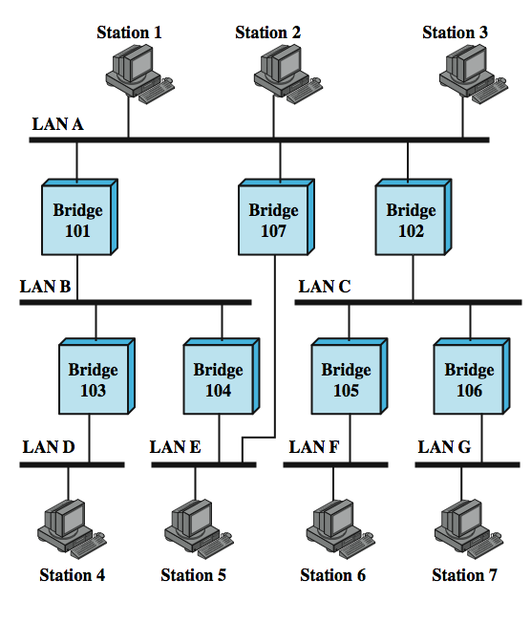
Routing
Alternative routes
Why?
For load balancing and fault tolerance
Based on what criteria?
Min-hop, delay, bandwidth et.
REPEATER
HUB
BRIDGE
SWITCH
ROUTER
GATEWAY
Notes:
There is a trend within many organisations to an increasing number of LANs interconnected by bridges. Consider the configuration of Stallings DCC8e Figure 15.10. Suppose that station 1 transmits a frame on LAN A intended for station 6. The frame will be read by bridges 101, 102, and 107. For each bridge, the addressed station is not on a LAN to which the bridge is attached. Therefore, each bridge must make a decision whether or not to retransmit the frame on its other LAN, in order to move it closer to its intended destination. In this case, bridge 102 should repeat the frame on LAN C, whereas bridges 101 and 107 should refrain from retransmitting the frame. Once the frame has been transmitted on LAN C, it will be picked up by both bridges 105 and 106., Each must decide whether or not to forward the frame. In this case, bridge 105 should retransmit the frame on LAN F, where it will be received by station 6.
The routing decision may not always be a simple one. Figure 15.10 also shows that there are two routes between LAN A and LAN E. Such redundancy provides for higher overall Internet availability and creates the possibility for load balancing. In this case, if station 1 transmits a frame on LAN A intended for station 5 on LAN E, then either bridge 101 or bridge 107 could forward the frame. It would appear preferable for bridge 107 to forward the frame, since it will involve only one hop, whereas if the frame travels through bridge 101, it must suffer two hops. Another consideration is that there may be changes in the configuration. For example, bridge 107 may fail, in which case subsequent frames from station 1 to station 5 should go through bridge 101. So the routing capability must take into account the topology of the internet configuration and may need to be dynamically altered.

Slide 35
Routing: Spanning Tree Algorithm
For any connected graph there is a spanning tree maintaining connectivity with no closed loops
IEEE 802.1 Spanning Tree Algorithm
Each bridge is assigned unique identifier
Exchanges info between bridges to find spanning tree
Is automatically updated whenever topology changes
Notes:
The address learning mechanism described previously is effective if the topology of the internet is a tree; that is, if there are no alternate routes in the network. The existence of alternate routes means that there is a closed loop., which means multiple copies of a frame may be delivered. For example in Figure 15.10, the following is a closed loop: LAN A, bridge 101, LAN B, bridge 104, LAN E, bridge 107, LAN A. To overcome this problem, a simple result from graph theory is used: For any connected graph, consisting of nodes and edges connecting pairs of nodes, there is a spanning tree of edges that maintains the connectivity of the graph but contains no closed loops. In terms of internets, each LAN corresponds to a graph node, and each bridge corresponds to a graph edge. Thus, in Figure 15.10, the removal of one (and only one) of bridges 107, 101, and 104, results in a spanning tree. What is desired is to develop a simple algorithm by which the bridges of the internet can exchange sufficient information to automatically (without user intervention) derive a spanning tree. The algorithm must be dynamic. That is, when a topology change occurs, the bridges must be able to discover this fact and automatically derive a new spanning tree. The spanning tree algorithm developed by IEEE 802.1, as the name suggests, is able to develop such a spanning tree. All that is required is that each bridge be assigned a unique identifier and that costs be assigned to each bridge port. In the absence of any special considerations, all costs could be set equal; this produces a minimum-hop tree. The algorithm involves a brief exchange of messages among all of the bridges to discover the minimum-cost spanning tree. Whenever there is a change in topology, the bridges automatically recalculate the spanning tree.

Slide 36
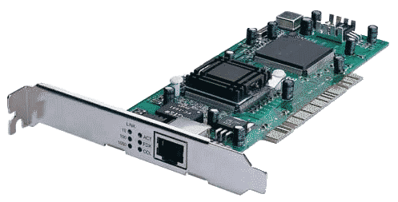
MAC address
unique 48-bit address which is hardwired into each network card
MAC address is linked to an IP address for use over the Internet
ARP Address Resolution Protocol – dynamic mapping table
determines whether a route to a destination exists
00-1C-C2-1B-A1-D4

Slide 37
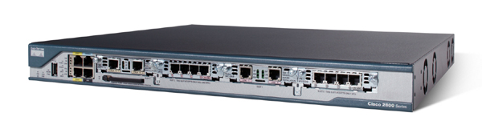
Internetworking: Router
Gateway is a network node equipped for interfacing with another network that uses different protocols
Acts as entrance to other networks.
A router routes packets to other networks
Nowadays routers typically include the functionality of a switch (or hub), gateway etc.
Typically connected to two LANs or a LAN and the Internet Service Provider (ISP)
They use a variety of protocols to route packets
REPEATER
HUB
BRIDGE
SWITCH
ROUTER
GATEWAY
Notes:
In virtually all cases, there is a need to expand beyond the confines of a single LAN, to provide interconnection to other LANs and to wide area networks. Two general approaches are used for this purpose: bridges and routers. The bridge is the simpler of the two devices and provides a means of interconnecting similar LANs. Because the devices all use the same protocols, the amount of processing required at the bridge is minimal. More sophisticated bridges are capable of mapping from one MAC format to another. There are several reasons for the use of multiple LANs connected by bridges:
• Reliability: By using bridges, the network can be partitioned into self-contained units, to provide fault isolation
• Performance: A number of smaller LANs will often give improved performance if devices can be clustered so that intranetwork traffic significantly exceeds internetwork traffic.
• Security: The establishment of multiple LANs may improve security of communications, keeping different types of traffic with different security needs on physically separate media.
• Geography: Clearly, two separate LANs are needed to support devices clustered in two geographically distant locations.

Slide 38
Internetworking: Why bother?
Why not have one big LAN?
Reliability
Faults would spread throughout the network
Security
Different types of users/information would all use the same network
Cost / Geography
Too expensive to build a LAN over a large geographical area
REPEATER
HUB
BRIDGE
SWITCH
ROUTER
GATEWAY
Notes:
repeater
interconnects similar LAN segments to form an extended LAN
bridge
interconnects similar LANs to form a single subnetwork
router
interconnects subnetworks to form a single network
gateway
interconnect different networks to form an integrated network

Slide 39
High-Speed LANs
Why?
Notes:
Speed and power of PCs have risen
More demanding applications (e.g. video transmission, massive databases etc.)
Centralised server farms: In many applications, there is a need for user, or client, systems to be able to draw huge amounts of data from multiple centralized servers, called server farms. As the performance of the servers themselves has increased, the bottleneck has shifted to the network.

Slide 40
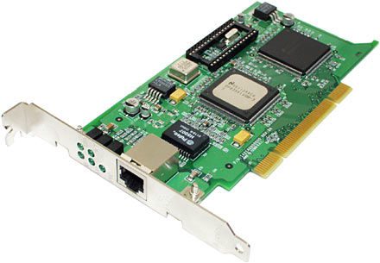
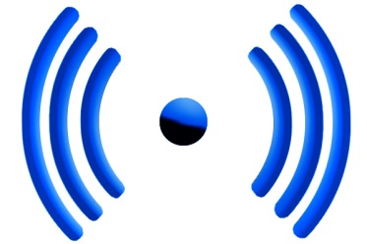
High-Speed LANs: Types
Gigabit Ethernet
High-speed Wi-Fi
Extension of the older 10-Mbps and 100-Mbps CSMA/CD
No need to change previous infrastructure
Wireless
Very convenient
Increasingly popular
But easy to eavesdrop and often unreliable
Notes:
The most important of these are
• Gigabit Ethernet: The extension of 10-Mbps CSMA/CD (carrier sense multiple access with collision detection) to higher speeds is a logical strategy, because it tends to preserve the investment in existing systems.
• High-speed wireless LANs: Wireless LAN technology and standards have come of age and high-speed standards and products have been introduced

Slide 41
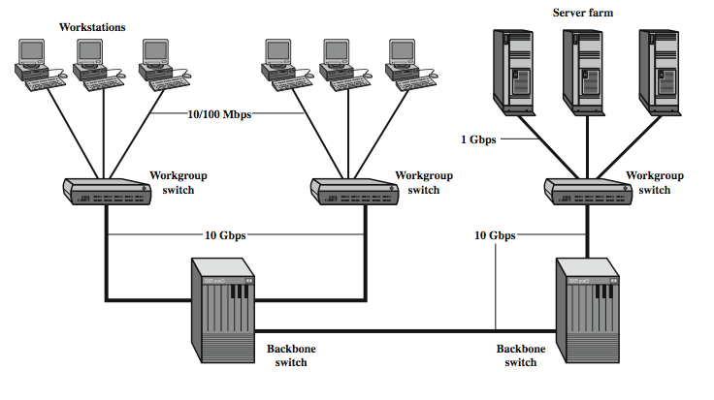
High-Speed LANs: Typical Gigabit topology
Gigabit Ethernet
Extension of the older 10-Mbps and 100-Mbps CSMA/CD
No need to change previous infrastructure

Slide 42
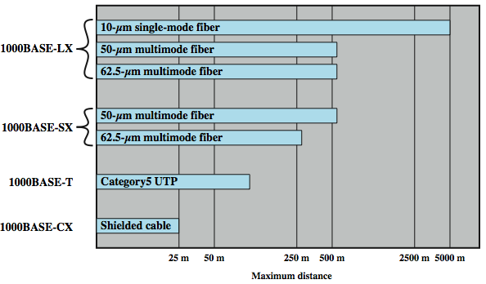
High-Speed LANs: Gigabit Ethernet types
Gigabit Ethernet
Extension of the older 10-Mbps and 100-Mbps CSMA/CD
No need to change previous infrastructure
Notes:
The current 1-Gbps specification for IEEE 802.3 includes the following physical layer alternatives, shown above in Stallings DCC8e Figure 16.5:
• 1000BASE-SX: This short-wavelength option supports duplex links of up to 275 m using 62.5-µm multimode or up to 550 m using 50-µm multimode fiber. Wavelengths are in the range of 770 to 860 nm.
• 1000BASE-LX: This long-wavelength option supports duplex links of up to 550 m of 62.5-µm or 50-µm multimode fiber or 5 km of 10-µm single-mode fiber. Wavelengths are in the range of 1270 to 1355 nm.
• 1000BASE-CX: This option supports 1-Gbps links among devices located within a single room or equipment rack, using copper jumpers (specialized shielded twisted-pair cable that spans no more than 25 m). Each link is composed of a separate shielded twisted pair running in each direction.
• 1000BASE-T: This option makes use of four pairs of Category 5 unshielded twisted pair to support devices over a range of up to 100 m.
The signal encoding scheme used for the first three Gigabit Ethernet options just listed is 8B/10B. The signal-encoding scheme used for 1000BASE-T is 4D-PAM5, a complex scheme whose description is beyond our scope.

Slide 43
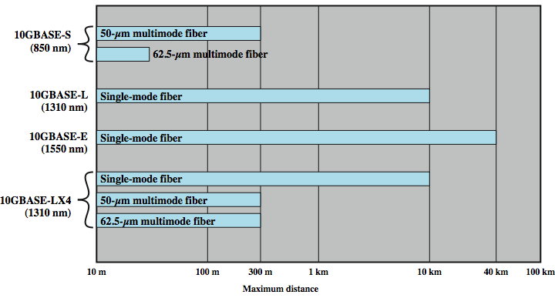
High-Speed LANs: 10-Gigabit Ethernet types
Gigabit Ethernet
Extension of the older 10-Mbps and 100-Mbps CSMA/CD
No need to change previous infrastructure
Notes:
Four physical layer options are defined for 10-Gbps Ethernet, as shown in Stallings DCC8e Figure 16.). The first three of these have two suboptions: an "R" suboption and a "W" suboption. The R designation refers to a family of physical layer implementations that use a signal encoding technique known as 64B/66B. The R implementations are designed for use over dark fiber, meaning a fiber optic cable that is not in use and that is not connected to any other equipment. The W designation refers to a family of physical layer implementations that also use 64B/66B signaling but that are then encapsulated to connect to SONET equipment. The four physical layer options are:
• 10GBASE-S (short): Designed for 850-nm transmission on multimode fiber. This medium can achieve distances up to 300 m. There are 10GBASE-SR and 10GBASE-SW versions.
• 10GBASE-L (long): Designed for 1310-nm transmission on single-mode fiber. This medium can achieve distances up to 10 km. There are 10GBASE-LR and 10GBASE-LW versions.
• 10GBASE-E (extended): Designed for 1550-nm transmission on single-mode fiber. This medium can achieve distances up to 40 km. There are 10GBASE-ER and 10GBASE-EW versions.
• 10GBASE-LX4: Designed for 1310-nm transmission on single-mode or multimode fiber. This medium can achieve distances up to 10 km. This medium uses wavelength-division multiplexing (WDM) to multiplex the bit stream across four light waves.

Slide 44

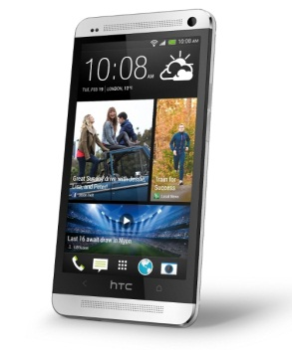
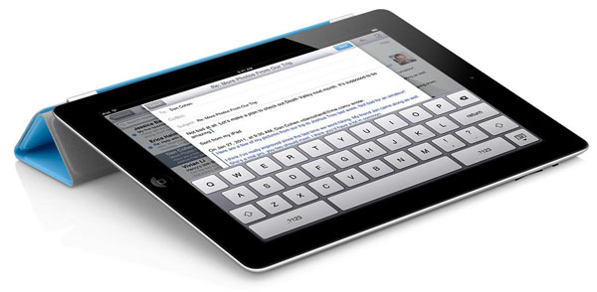
High-Speed LANs: Wi-Fi (IEEE 802.11)
Extends network where wires are impractical or expensive
Allows guests to connect easily and temporarily
Allows roaming around campus
HALF-DUPLEX. Devices share the channel. They cannot listen while transmitting and as a result they cannot detect collisions. Instead they try to avoid them by informing the rest that they are about to transmit before actually doing so (CSMA / CA = collision avoidance) and assume collision when ACKs are not received
High-speed Wi-Fi
Wireless
Very convenient
Increasingly popular
But easy to eavesdrop and often unreliable

Slide 45
So, what is a LAN anyway?
Twisted Pair
Opt. Fibre
Wireless
TOKEN RING
BUS
TREE
RING
STAR
Coaxial
CSMA
CSMA/CD
GUIDED
UNGUIDED
TOPOLOGY
TRANSMISSION MEDIUM
METHOD OF SHARING
A data network
that connects computers, printers and other devices
in a small geographical area
, over a variety of communication media,
at high speed
and in a fault-tolerant manner
and allows users to communicate and share devices and files
LAN
Local Area Network

